Slide 1
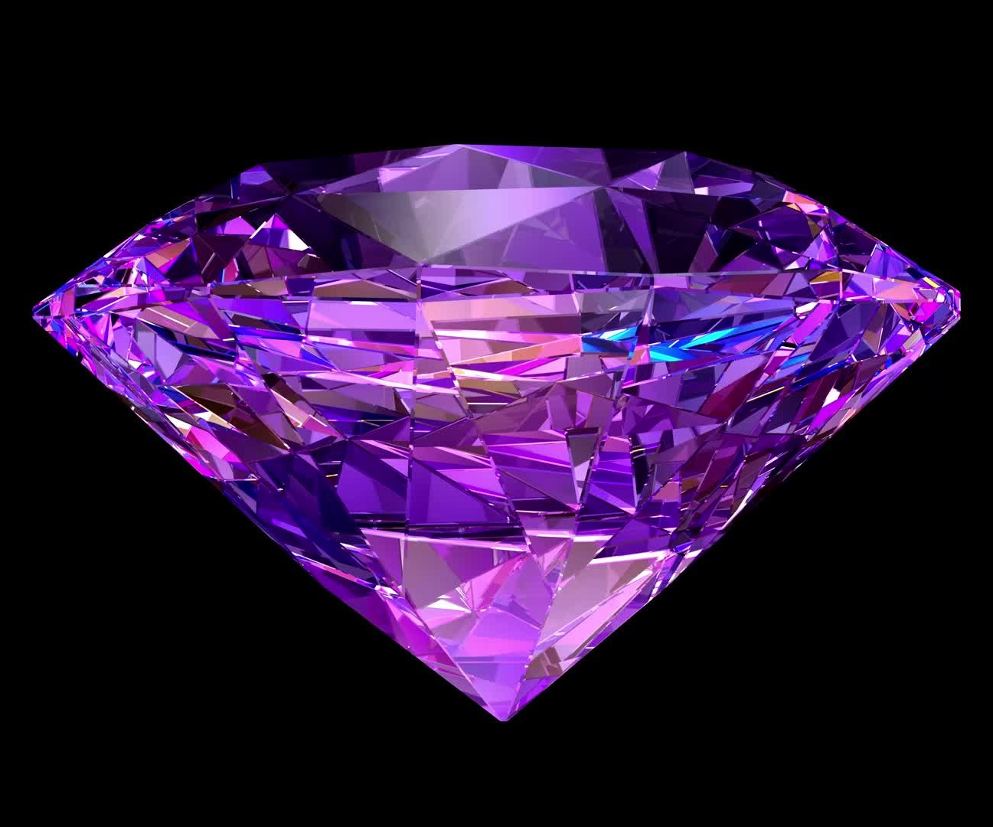
Minerals in Society
By Daniel Martinez

Slide 2

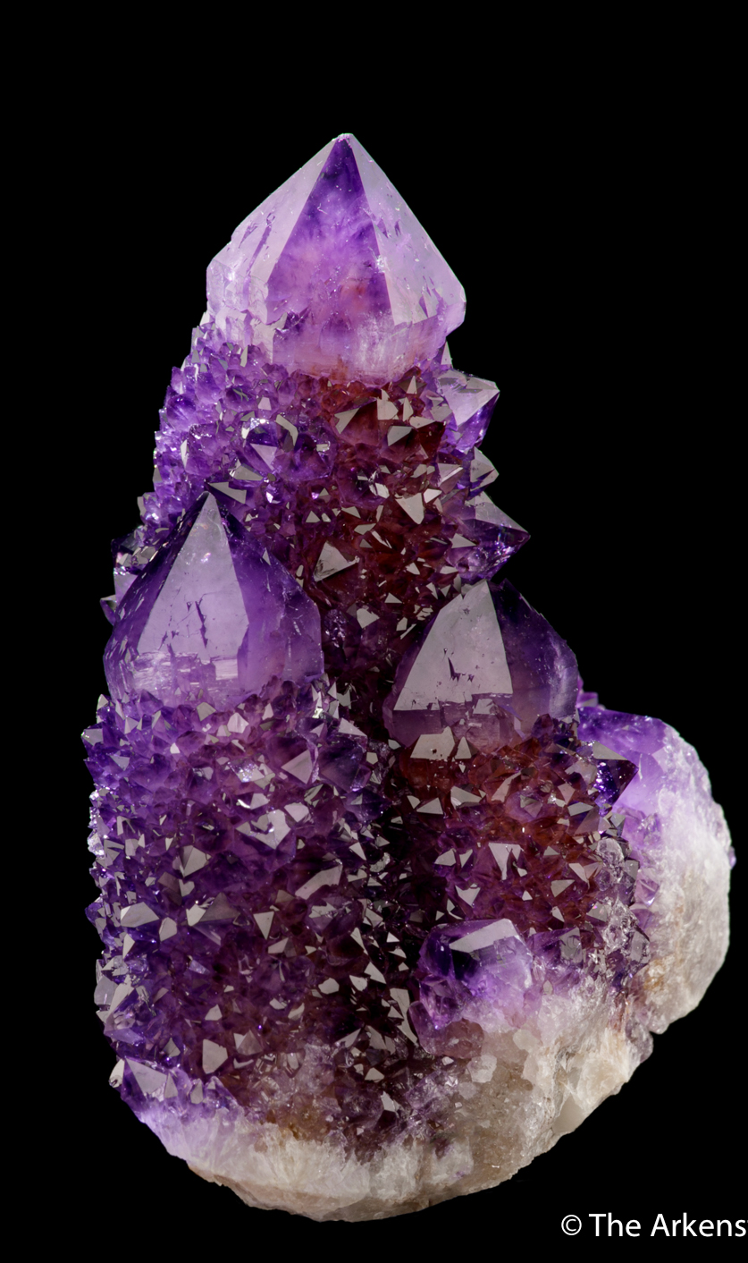
Major Sedimentary Minerals
Quartz
Chemical impurities gives quartz crystals a variety of colors that make for excellent gemstones.
Sands used for glass making are predominantly quartz and can be used to make practically every type of glass product.
Its use in hydraulic fracking is as a sand slurry that is pumped down into the earth and keeps any fractures open so companies can extract petroleum.
Quartz is used in electronics as an insulator and thermal regulator due to its ability to insulate electricity and dissipate heat.
Notes:
https://uniquecrystalminerals.com/quartz-applications/
https://geologyscience.com/minerals/quartz/#Quartz_Uses

Slide 3
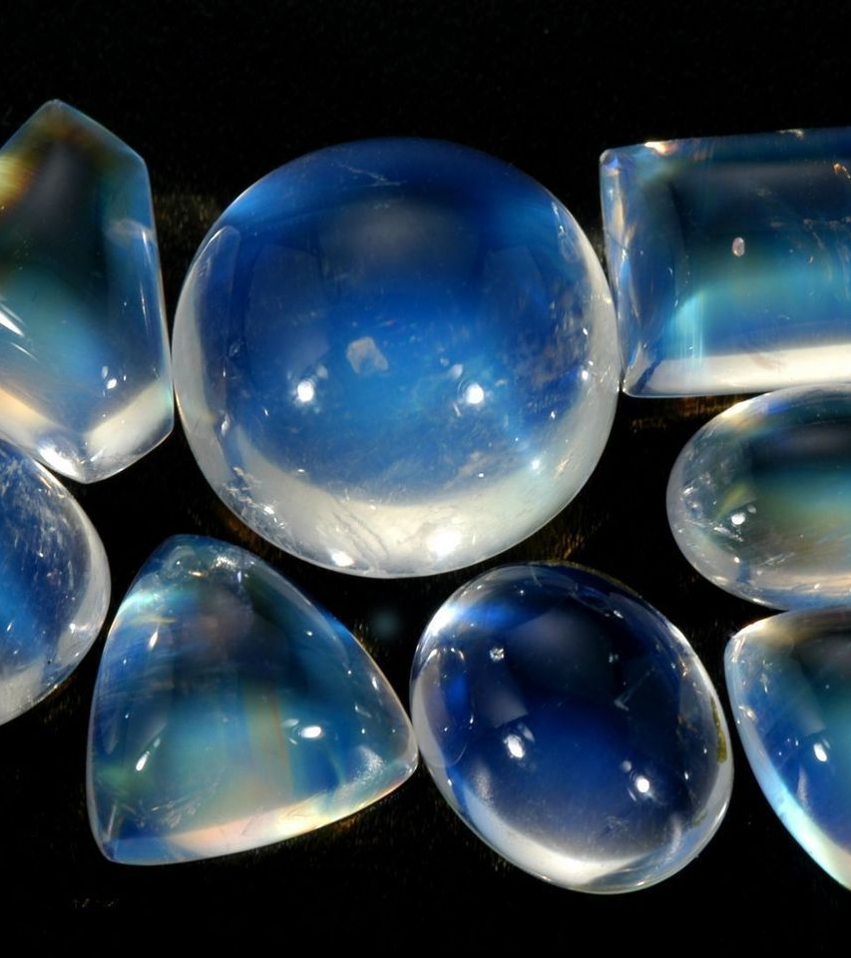
Major Sedimentary Minerals
Orthoclase
Orthoclase lowers the melting temperature for ceramics.
Orthoclase feldspars increase durability and hardness of glass.
Occasionally clear crystals of orthoclase feldspar are cut into gemstones.
Notes:
https://www.britannica.com/science/orthoclase
https://www.energy.virginia.gov/geology/feldspar.shtml#:~:text=In%20ceramics%2C%20the%20feldspar%20is,and%20other%20glass%2Dmaking%20applications.

Slide 4
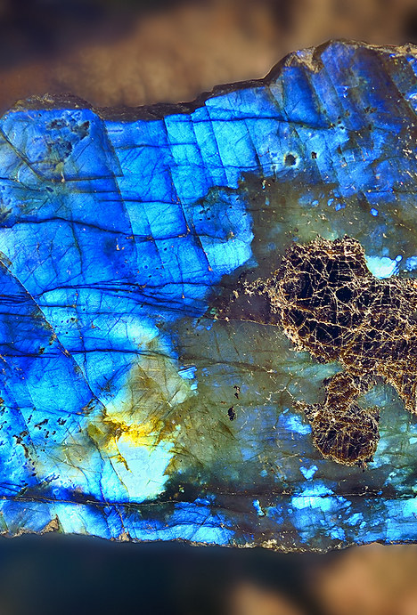
Major Sedimentary Minerals
Plagioclase
Labradorite and peristerite are considered as valuable gemstones and ornaments because of their iridescent appearance.
Plagioclase is also used in the production of glass to add chemical and physical strength
Plagioclase is used in ceramics to lower the melting temperature during manufacturing.
Notes:
https://www.britannica.com/science/plagioclase

Slide 5
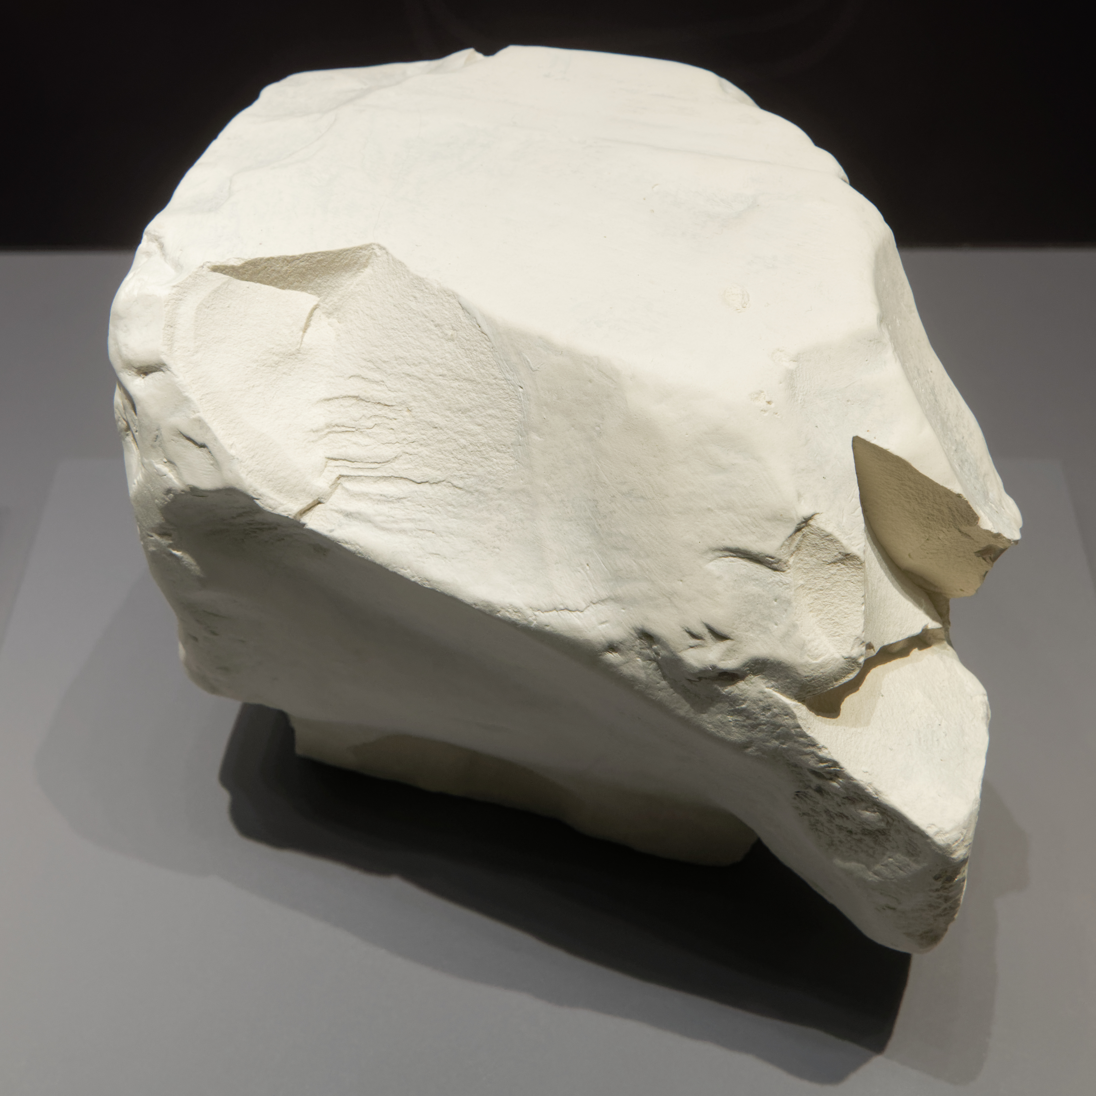
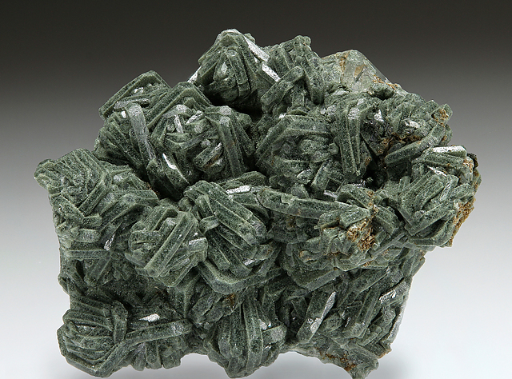
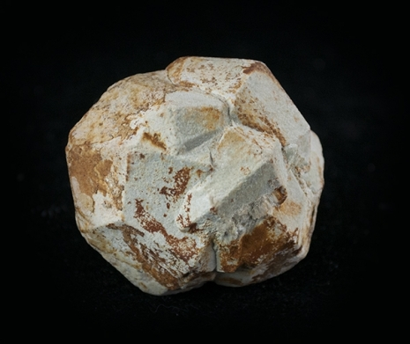
Major Clay Minerals
Kaolinite
Chlorite
Illite
Pharmaceutical products like toothpaste and blood clotting medicine
Agriculture as pesticides and sunscreen for apples
Cosmetics like skin creams
Herbicides, pesticides, algaecides, and fungicides
Water treatment as a disinfectant and to control hydrogen sulfide odors.
Food manufacturing as a sanitizing agent
oil and gas (sulfide-reducing bacteria control)
Soil conditioner
Filler for paints and papers
Drilling additive for oil and gas exploration
Face masks and skin creams due to its oil absorbing properties
Notes:
https://activeminerals.com/blog/kaolin-guide/#:~:text=It%20is%20extensively%20used%20in,%2C%20and%20non%2Dswelling%20capabilities.
https://www.epa.gov/system/files/documents/2023-03/Sodium%20Chlorite%20Supply%20Chain%20Profile.pdf
https://geologyscience.com/minerals/kaolinite/
https://geologyscience.com/minerals/chlorite/?amp
https://geologyscience.com/minerals/silicates-minerals/illite/?amp

Slide 6
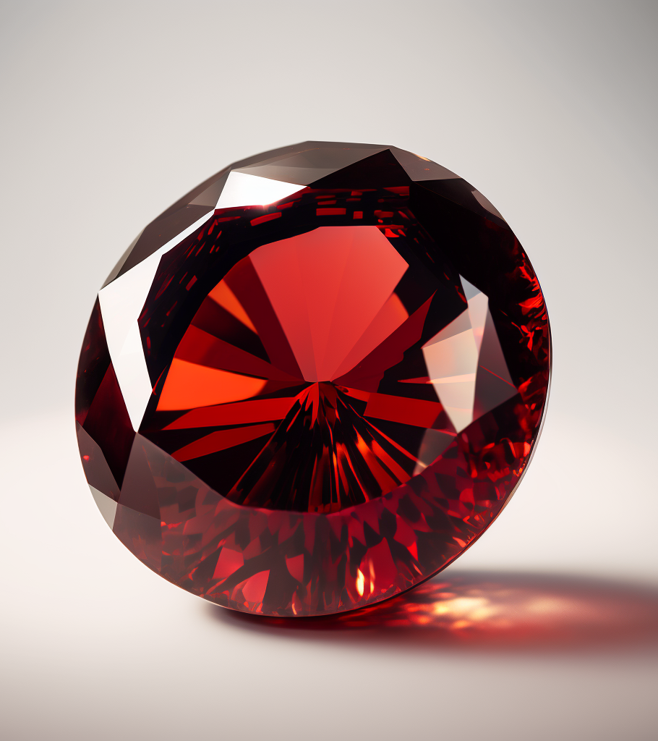
Accessory Minerals
Garnet is used primarily as gemstone and has a glassy red color.
Hematite is used as a pigment for paint, glazes and body decorations.
Hornblende is used in construction of highways and railroads.
Muscovite can be crushed up and used in electronics insulators, Paints, and can join cement.
Biotite has uses in manufacturing as a mold releasing agent and paint filler.
Magnetite is used to produce steel.
Notes:
https://www.gia.edu/garnet-description#:~:text=Garnets%20are%20a%20set%20of,reds%2C%20and%20even%20some%20blues.
https://commonminerals.esci.umn.edu/minerals-g-m/hematite#:~:text=Nearly%20every%20human%20society%20has,choice%20for%20painting%20large%20structures.
https://geology.com/minerals/hornblende.shtml#:~:text=Uses%20of%20Hornblende&text=It%20is%20crushed%20and%20used,countertops%2C%20and%20other%20architectural%20uses.
https://sites.google.com/site/geo143mineralwebpages/muscovite
https://geology.com/minerals/biotite.shtml#:~:text=Uses%20of%20Biotite&text=Ground%20mica%20is%20used%20as,asphalt%20shingles%20and%20rolled%20roofing.
https://www.acs.org/molecule-of-the-week/archive/m/magnetite.html#:~:text=Magnetite's%20greatest%20use%20is%20as,variety%20of%20processes%20and%20materials.

Slide 7
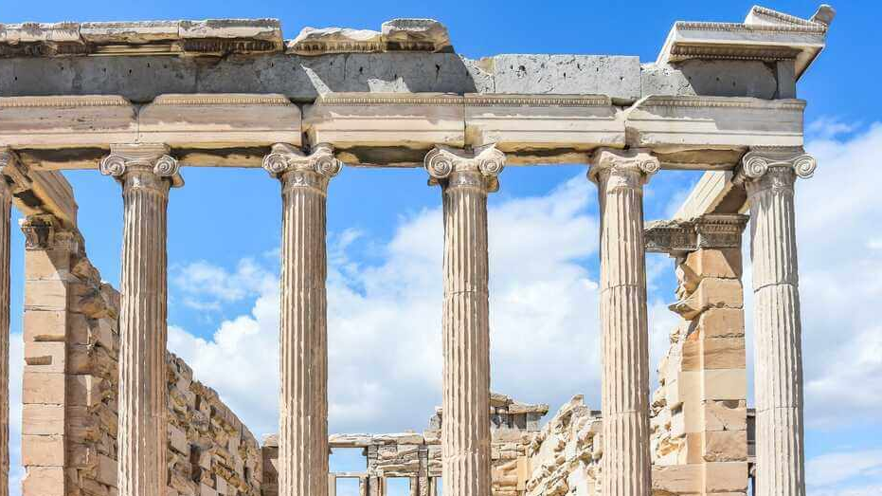
Other Minerals
Calcite is used in many industries such as anti-acids in pharmaceuticals, limestone in construction, acid neutralizer in chemical products and soils.
Gypsum is used to create building plaster, gypsum panels, and improve soil workability.
Halite is table salt.
Notes:
https://geology.com/minerals/halite.shtml
https://gypsum.org/other-uses-of-gypsum/#:~:text=While%20the%20majority%20of%20gypsum,the%20corrosive%20effect%20of%20alkalinity.
https://geology.com/minerals/calcite.shtml

Slide 8
Work Cited
Activeminerals. “The Properties of Kaolin and Its Applications: AMI.” Active Minerals International, 1 May 2023, activeminerals.com/blog/kaolin-guide/#:~:text=It%20is%20extensively%20used%20in,%2C%20and%20non%2Dswelling%20capabilities.
Agarwal, Dinesh. “Quartz Applications & Uses in Different Industries.” Unique Crystal Minerals, 19 Feb. 2020, uniquecrystalminerals.com/quartz-applications/.
“Biotite.” Geology, geology.com/minerals/biotite.shtml#:~:text=Uses%20of%20Biotite&text=Ground%20mica%20is%20used%20as,asphalt%20shingles%20and%20rolled%20roofing. Accessed 5 Dec. 2023.
“Calcite.” Geology, geology.com/minerals/calcite.shtml. Accessed 5 Dec. 2023.
“Feldspar.” Virginia Energy - Geology and Mineral Resources - Feldspar, www.energy.virginia.gov/geology/feldspar.shtml#:~:text=In%20ceramics%2C%20the%20feldspar%20is,and%20other%20glass%2Dmaking%20applications. Accessed 5 Dec. 2023.
“Garnet Description.” Gemological Institute Of America, www.gia.edu/garnet-description#:~:text=Garnets%20are%20a%20set%20of,reds%2C%20and%20even%20some%20blues. Accessed 5 Dec. 2023.
“Halite.” Geology, geology.com/minerals/halite.shtml. Accessed 5 Dec. 2023.
“Hematite.” Hematite | Common Minerals, commonminerals.esci.umn.edu/minerals-g-m/hematite#:~:text=Nearly%20every%20human%20society%20has,choice%20for%20painting%20large%20structures. Accessed 5 Dec. 2023.
“Hornblende.” Geology, geology.com/minerals/hornblende.shtml#:~:text=Uses%20of%20Hornblende&text=It%20is%20crushed%20and%20used,countertops%2C%20and%20other%20architectural%20uses. Accessed 5 Dec. 2023.

Slide 9
Work Cited
“Magnetite.” American Chemical Society, www.acs.org/molecule-of-the-week/archive/m/magnetite.html#:~:text=Magnetite’s%20greatest%20use%20is%20as,variety%20of%20processes%20and%20materials. Accessed 5 Dec. 2023.
MAT, Mahmut. “Chlorite: Variation, Properties, Formation, Occurrence and Uses.” Geology Science, 9 Sept. 2023, geologyscience.com/minerals/chlorite/?amp.
MAT, Mahmut. “Illite: Properties, Formation, Uses " Geology Science.” Geology Science, 1 May 2023, geologyscience.com/minerals/silicates-minerals/illite/?amp.
MAT, Mahmut. “Kaolinite Properties, Occurrence and Uses Area.” Geology Science, 23 Apr. 2023, geologyscience.com/minerals/kaolinite/.
MAT, Mahmut. “Quartz: Properties, Varieties, Occurrence and Uses.” Geology Science, 8 Nov. 2023, geologyscience.com/minerals/quartz/#Quartz_Uses.
“Muscovite.” GEO143 Mineral Webpages, sites.google.com/site/geo143mineralwebpages/muscovite. Accessed 5 Dec. 2023.
“Orthoclase.” Encyclopædia Britannica, Encyclopædia Britannica, inc., www.britannica.com/science/orthoclase. Accessed 5 Dec. 2023.
“Other Uses of Gypsum.” Gypsum Association, gypsum.org/other-uses-of-gypsum/#:~:text=While%20the%20majority%20of%20gypsum,the%20corrosive%20effect%20of%20alkalinity. Accessed 5 Dec. 2023.
“Plagioclase.” Encyclopædia Britannica, Encyclopædia Britannica, inc., www.britannica.com/science/plagioclase. Accessed 5 Dec. 2023.
U.S. Environmental Protection Agency | US EPA, www.epa.gov/system/files/documents/2023-03/Sodium%20Chloride%20Supply%20Chain%20Profile.pdf. Accessed 6 Dec. 2023.

