Slide 1

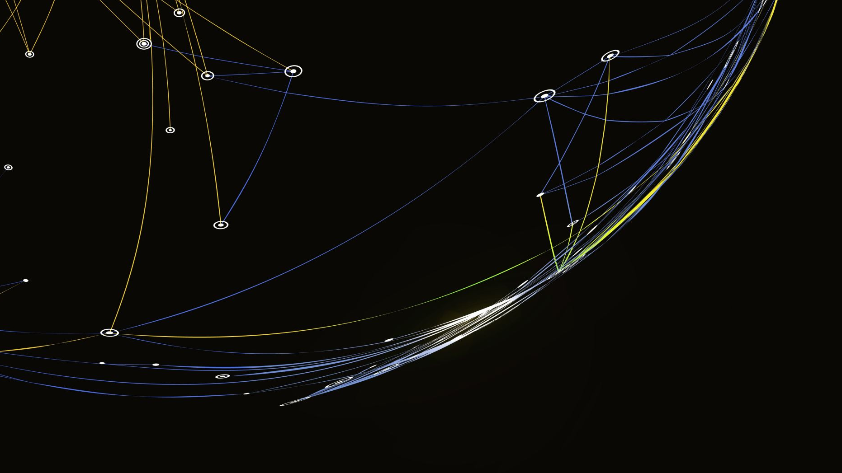

Bedding plane markings
By Daniel Martinez

Slide 2
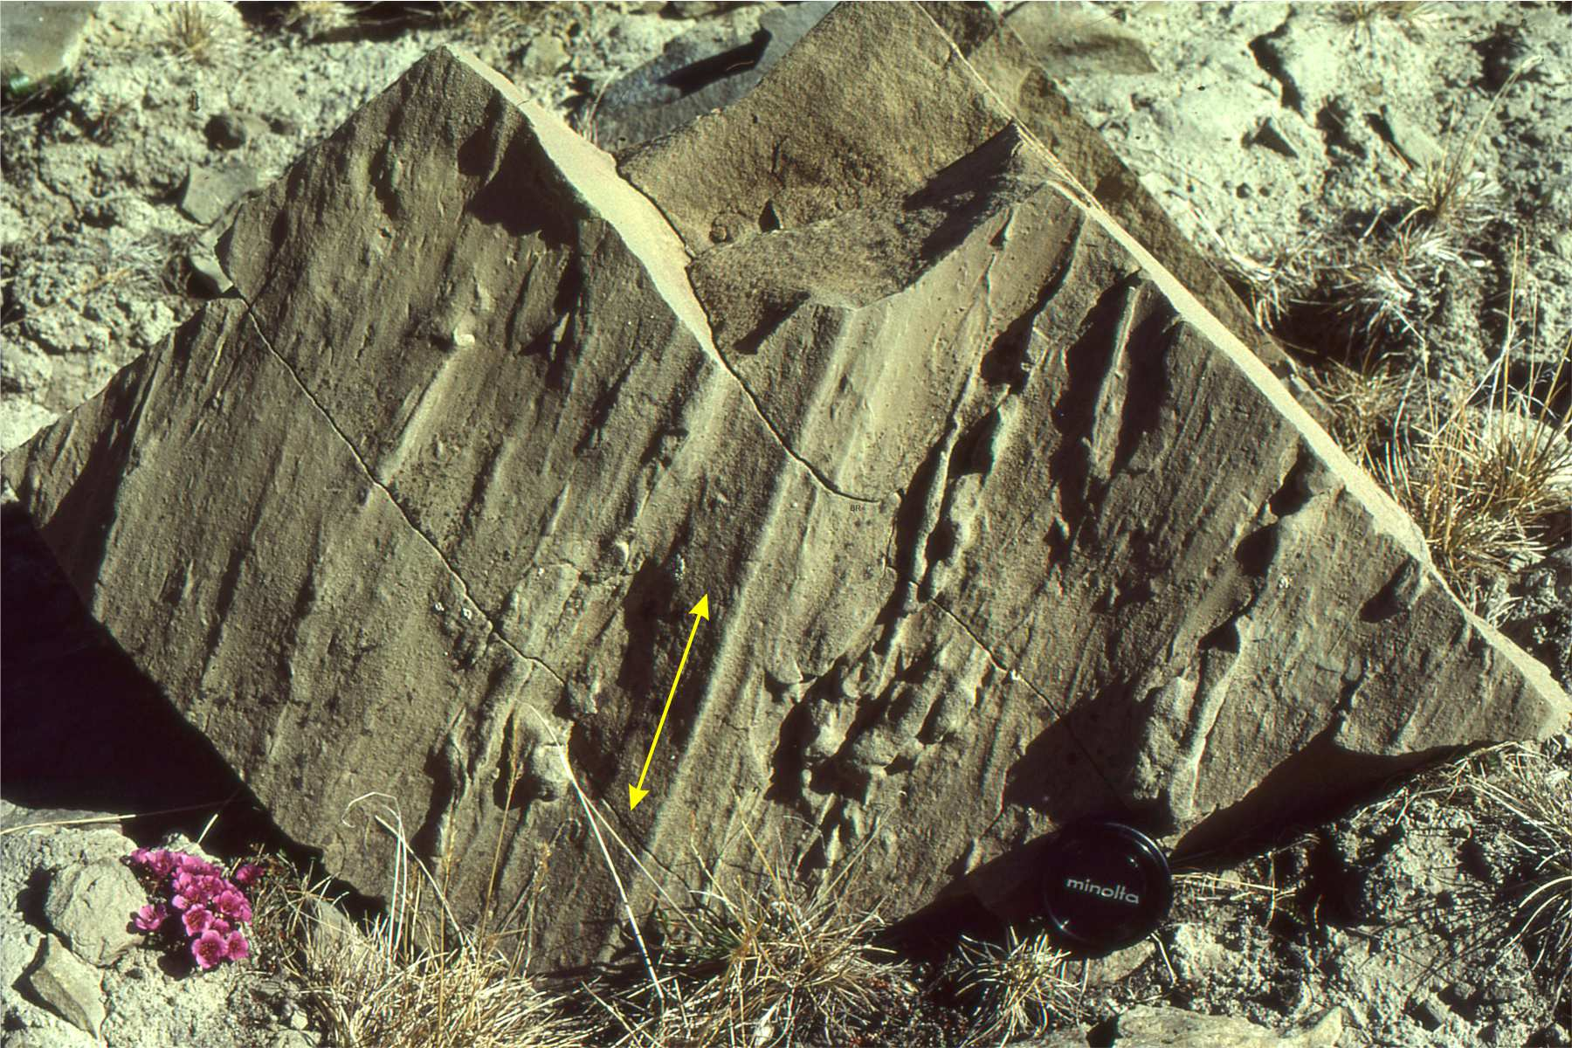
Groove casts
Formed by an object being dragged across the surface by a strong current
Flow current is in the direction parallel to the cast
Forms in turbidity currents
Length can rage from a few millimeters to several centimeters
Phillips, Rachel. “The Ultimate Guide to Bedding Plane Markings- SED Strat #7 | Geo Girl.” YouTube, YouTube, 27 Mar. 2022, www.youtube.com/watch?app=desktop&v=2tHT4ImkiaM.
Ricketts, Brian. “Groove Casts Archives.” Geological Digressions, 6 Feb. 2019, www.geological-digressions.com/tag/groove-casts/#:~:text=Groove%20casts%20Objects%20dragged%20across,on%20the%20soles%20of%20beds.
Jr., Sam Boggs. “Chapter 4.” Principles of Sedimentology and Stratigraphy, 5th ed., Pearson, 2011, pp. 84–87.

Slide 3
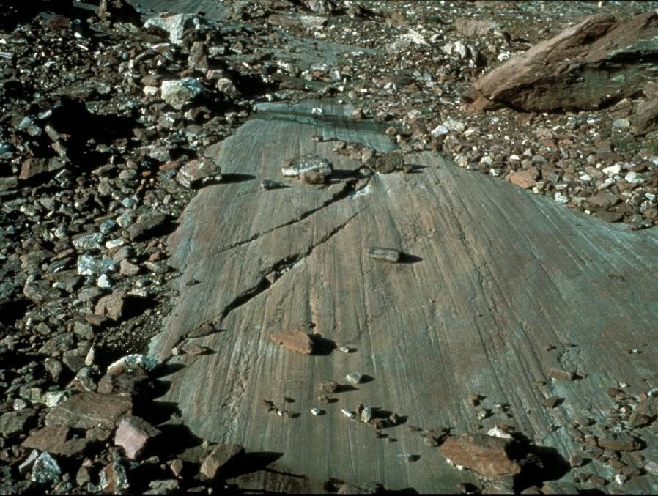
striations
Scratches visible to the naked eye made by sliding glaciers
Lengths range from a few millimeters to a few centimeters
Depth fractions of millimeters to a few millimeters
Shows the direction of flow for ice
“Striation.” Encyclopædia Britannica, Encyclopædia Britannica, inc., www.britannica.com/science/striation-geology. Accessed 21 Sept. 2023.
Brooks, J., Smith, L., Hansen, D., Tovar, A., & Zoet, L. (2023). The morphology of striations produced during laboratory experiments of subglacial abrasion. Abstracts with Programs - Geological Society of America, 55(3), Abstract no. 25-4. https://doi.org/10.1130/abs/2023NC-386809
Notes:
https://www.britannica.com/science/striation-geology
https://www.proquest.com/georef/docview/2848587884/A70B4DEE679C44A5PQ/1?accountid=12299

Slide 4
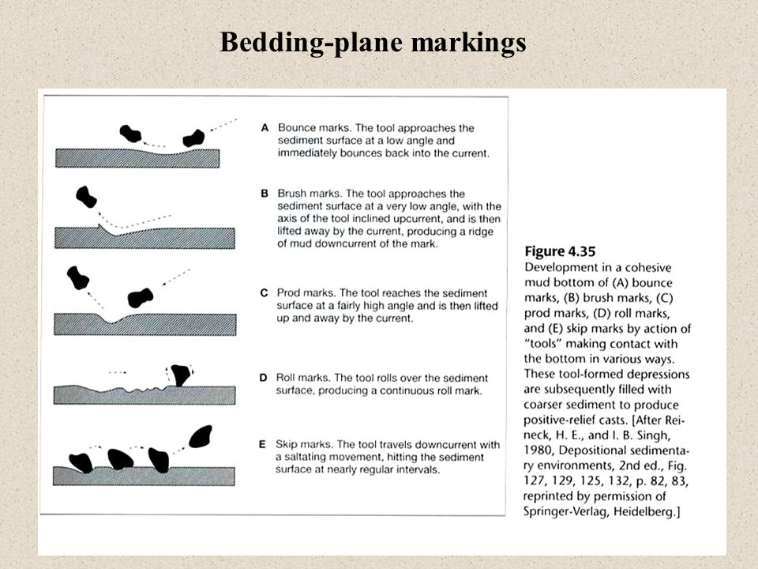
Bounce, brush, prod, & roll marks
Bounce marks are made from objects bouncing along the bottom of a river
Brush marks are made form an object brushing against the ground
Brush marks leave a small hill from impact in the direction of the current
Prod marks are made form objects striking the ground and getting stuck then removed from the mud
Roll marks are made by an object rolling across the bottom leaves behind characteristic marks
Phillips, Rachel. “The Ultimate Guide to Bedding Plane Markings- SED Strat #7 | Geo Girl.” YouTube, YouTube, 27 Mar. 2022, www.youtube.com/watch?app=desktop&v=2tHT4ImkiaM.
Jr., Sam Boggs. “Chapter 4.” Principles of Sedimentology and Stratigraphy, 5th ed., Pearson, 2011, pp. 84–87.
Notes:
https://www.youtube.com/watch?app=desktop&v=2tHT4ImkiaM

Slide 5
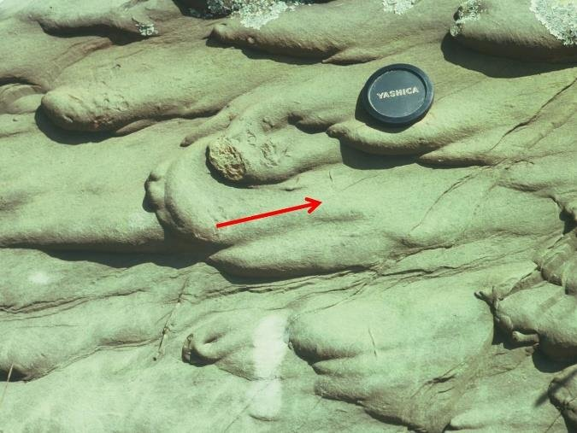
Flute casts
Commonly created by strong eddies turbidity currents
Formed by filing depression in the bottom layer
Flow direction goes from narrow to wider
Can occur individually or in swarms
Multiple flute casts will have the same general orientation
Size is typically consistent in the same bed
Phillips, Rachel. “The Ultimate Guide to Bedding Plane Markings- SED Strat #7 | Geo Girl.” YouTube, YouTube, 27 Mar. 2022, www.youtube.com/watch?app=desktop&v=2tHT4ImkiaM.
Ricketts, Brian. “Groove Casts Archives.” Geological Digressions, 6 Feb. 2019, www.geological-digressions.com/tag/groove-casts/#:~:text=Groove%20casts%20Objects%20dragged%20across,on%20the%20soles%20of%20beds.
Jr., Sam Boggs. “Chapter 4.” Principles of Sedimentology and Stratigraphy, 5th ed., Pearson, 2011, pp. 84–87.
Notes:
https://www.geological-digressions.com/tag/groove-casts/#:~:text=Groove%20casts%20Objects%20dragged%20across,on%20the%20soles%20of%20beds.
https://www.youtube.com/watch?app=desktop&v=2tHT4ImkiaM

Slide 6
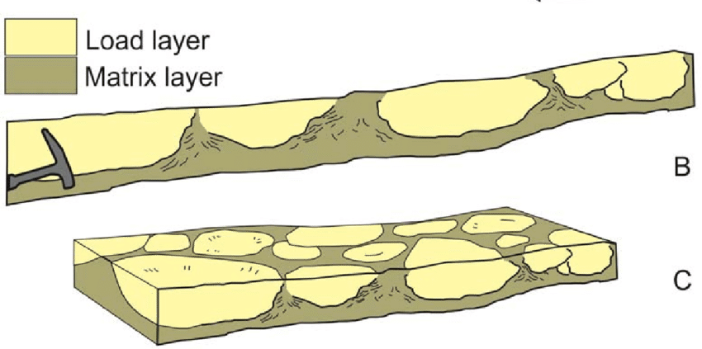
Load casts
Load casts are formed by deformation
Denser layer sinks into a less dense layer
Typically forms because of a sandstone bed being on top of a mudstone or shale bed
To form Underlying bed must be saturated or uncompacted
Irregular shape distinguishes load casts from flute casts
Orientation is not determined by flow direction.
Can modify the relief of flute and groove casts
Phillips, Rachel. “The Ultimate Guide to Bedding Plane Markings- SED Strat #7 | Geo Girl.” YouTube, YouTube, 27 Mar. 2022, www.youtube.com/watch?app=desktop&v=2tHT4ImkiaM.
Jr., Sam Boggs. “Chapter 4.” Principles of Sedimentology and Stratigraphy, 5th ed., Pearson, 2011, pp. 84–87.
Notes:
https://www.youtube.com/watch?app=desktop&v=2tHT4ImkiaM

